Slide 1
My grandfather says summers are getting hotter
Yixuan Zhao; Ehsan Ul Hoque Tanim; Hang Tian
SUNY-BUFFALO-GEO-511-SDS
Week 2

Slide 2

Load Data
library(tidyverse)
# define the link to the data - you can try this in your browser too. Note that the URL ends in .txt.
dataurl=https://data.giss.nasa.gov/tmp/gistemp/STATIONS/tmp_USW00014733_14_0_1/station.txt
#the next line tells the NASA site to create the temporary file
httr::GET("https://data.giss.nasa.gov/cgi-bin/gistemp/stdata_show_v4.cgi?id=USW00014733&ds=14&dt=1")
# the next lines download the data
temp=read_table(dataurl,
skip=3, #skip the first line which has column names
na="999.90", # tell R that 999.90 means missing in this dataset
col_names = c("YEAR","JAN","FEB","MAR", # define column names
"APR","MAY","JUN","JUL",
"AUG","SEP","OCT","NOV",
"DEC","DJF","MAM","JJA",
"SON","metANN"))
# renaming is necessary becuase they used dashes ("-")
# in the column names and R doesn't like that.

Slide 3
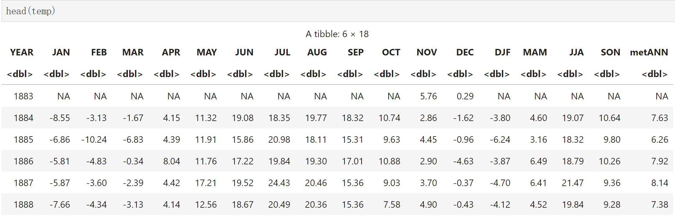
How looks like

Slide 4
dat = temp[,7:9] # Extract column JJA
years = temp[,1] # Extract column years
row_mean = apply(dat,1,mean) # Find the mean value of JJA by row
JJA_mean = data.frame(row_mean) # change type to data frame
JJA_years = cbind(years,JJA_mean) # Combining year and mean
library(ggplot2)
ggplot(data = JJA_years, mapping = aes(x = YEAR, y = row_mean, group = 1))
+ geom_line()
+ geom_smooth()
+ labs(x = "Year", y = "Mean Summer Temperatures (C°)", title = "Mean Summer Temperatures in Buffalo, NY", subtitle = "Summer includes June, July, and August
Data from the Global Historical Climate Network
Blue line is a LOESS smooth", caption = "Data: NASA
tag = "Fig. 1")
+ theme(axis.text.x = element_text(size = 20),axis.text.y = element_text(size = 20),title = element_text(size = 30))
Data processing and visualization

Slide 5
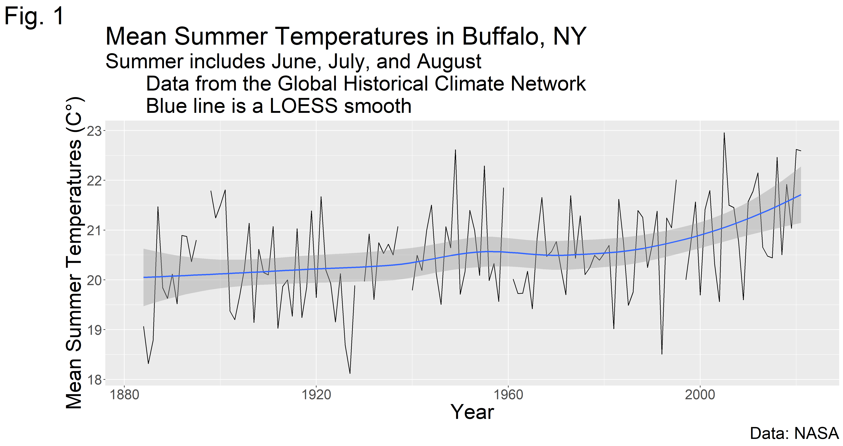
ggsave(
filename = "Mean Summer Temperatures in Buffalo.png",
width = 17,
height = 9,
units = "in",
dpi = 300)

